Slide 1


Slide 2





Demographic Profile
Owners
Renters
Median Age: 52
Median Age: 37
2007
Median Household Income: $58k
Median Household Income: $24.6k
Median Household Cost: $940
Median Household Cost: $655
Median Age: 53
Median Age: 37
2009
Median Household Income: $58k
Median Household Income: $24k
Median Household Cost: $1007
Median Household Cost: $706
Median Age: 55
Median Age: 39
2011
Median Household Income: $57.7k
Median Household Income: $23.9k
Median Household Cost: $1026
Median Household Cost: $743

Slide 3
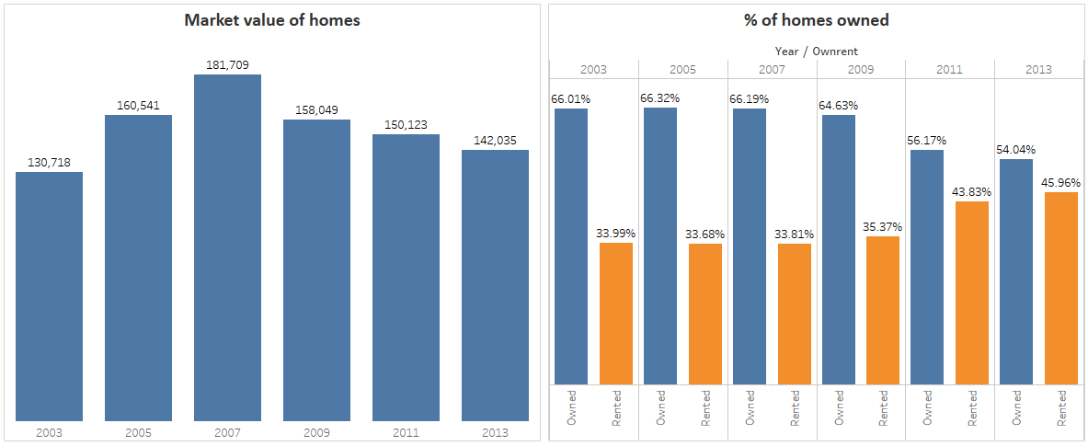
Recession Impact
The Market value of homes see’s a significant drop and the percentages of homes rented shows a huge increase

Slide 4

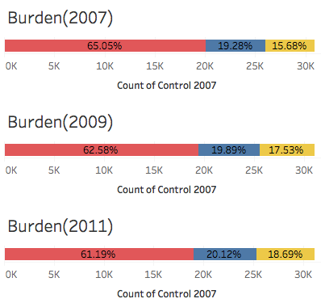
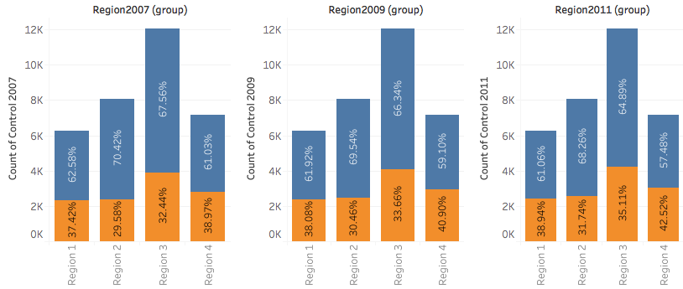
Housing as a % of Income
Shift in Burden
2007
< 30%
30-50%
> 50%
Overall, during the period of 2007 – 2011, there is a:
2009
Decrease in number of houses with lesser than 30% burden
Increase in number of houses with greater than 30% burden
< 30%
30-50%
> 50%
2011
3.86%
< 30%
30-50%
>50%
The total effect of the shift is
There is overall decrease in properties owned, regardless of region.
Region 1 experience the least change in status of
0.75%

Slide 5


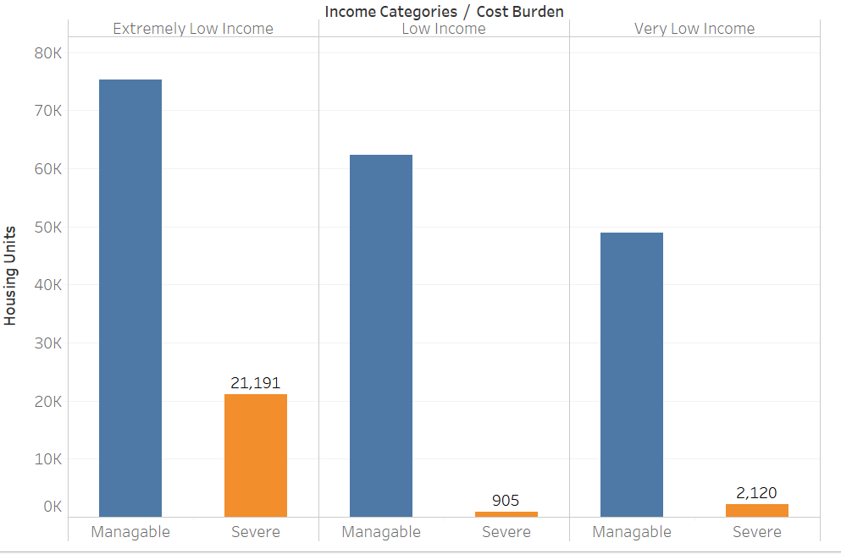
Cost Burden on Low Income
Cost Burden – Housing cost divided by Income
If cost burden greater than 1, it’s categorized as severe burden or else manageable
Extremely low income have the highest severe cost burden

Slide 6
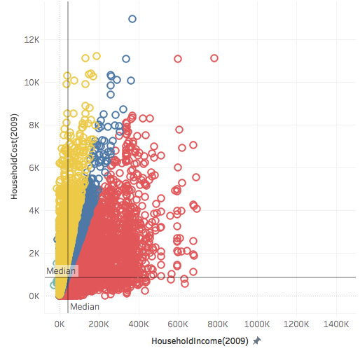

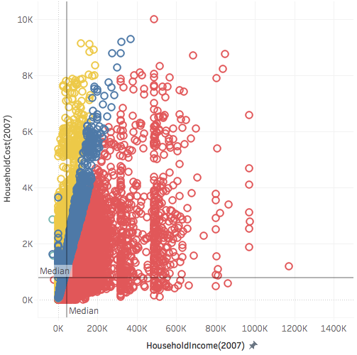
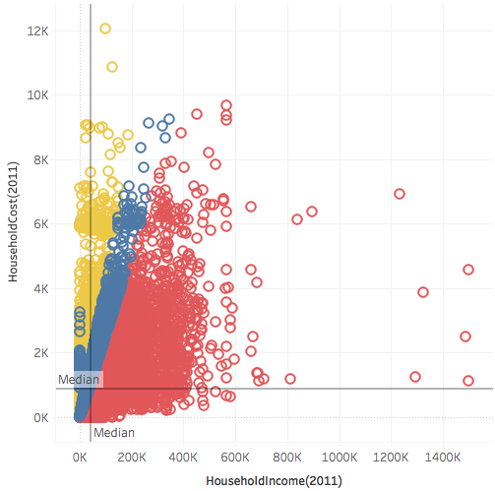
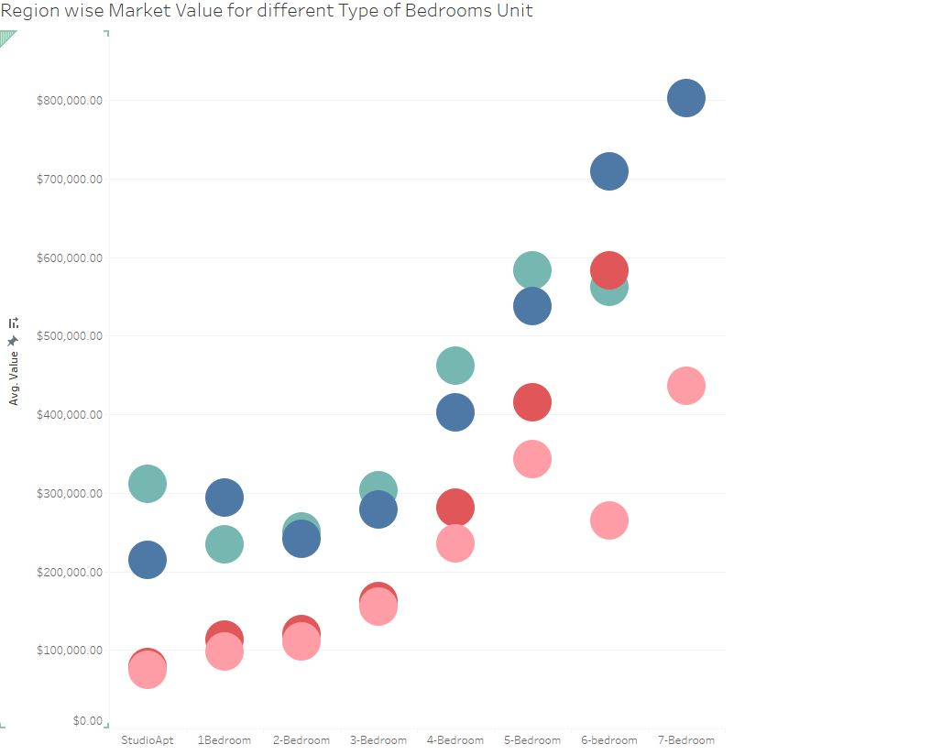
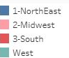
Safe Zone
The shift in burden (line) shows that at the height of the housing crisis, people were over-leveraging. This continued into 2011.
Regardless of the years, larger number of bedrooms are associated with larger median income!

Slide 7
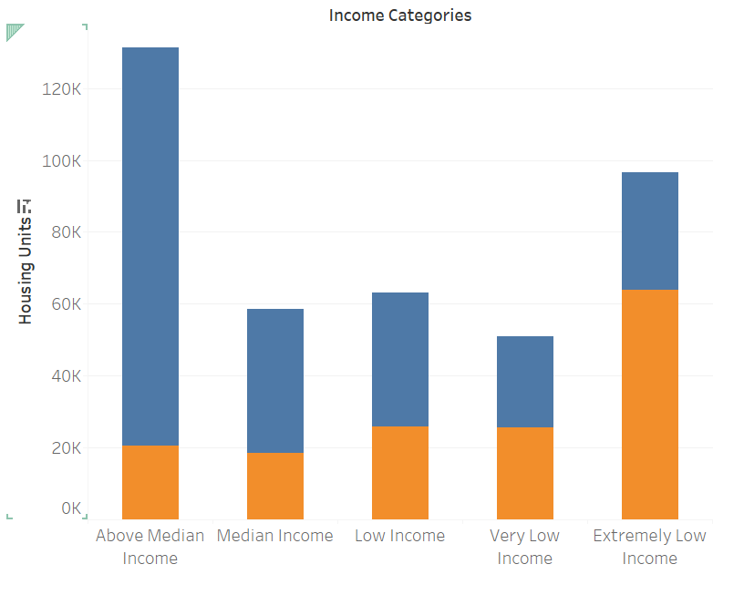


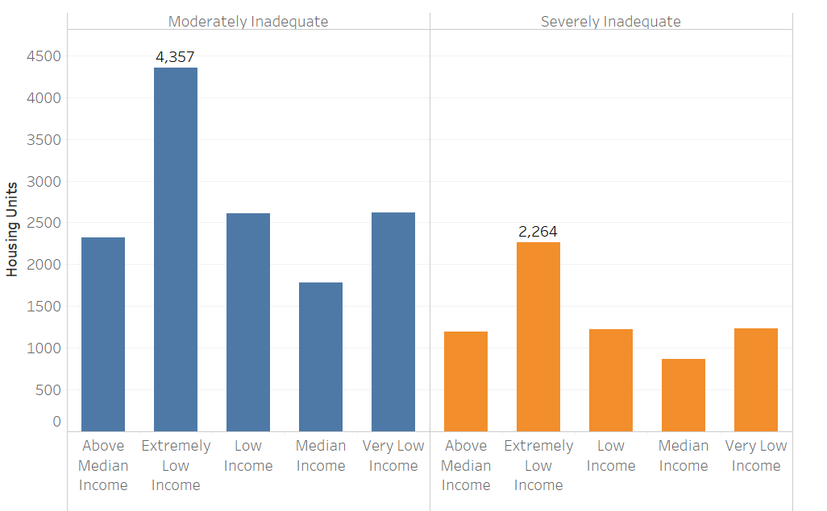
Renting is by Economic Condition, not by choice
As income decreases, people opt to rent a house.
Adequacy is the number of people per room
Moderately Adequate and Severely Adequate have value of Adequacy greater than 1
Poverty drives the number of occupants in a room

Slide 8

Effects of Crisis
Noticeably, there is a decline in value of houses from 2007 to 2011.
The region with the largest decline is
Region 4
($88,412)
The region with the smallest decline is
Region 1
($22,638)
Correspondingly, Region 1 and 4 have the highest median household income.
Therefore
In 2011, region 4 would have been a prime choice for real-estate investment.
Houses were under-valued!

Slide 10

Title
Title
Title
Title
Title
Title

Slide 11


Slide 12




Tools Used

Slide 13


Slide 14

League

Slide 15


